Slide 2
Investors watch an electronic board showing stock information at a brokerage office in Beijing, China.

Slide 3
Investors watch an electronic board showing stock information at a brokerage office in Beijing, China.

Slide 4
Visitors watch water gushing from the section of the Xiaolangdi Reservoir on the Yellow River, during a sand-washing operation

Slide 5
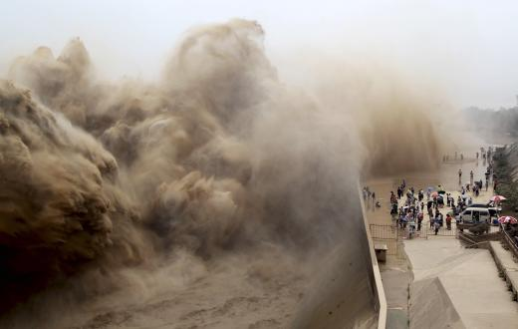

Slide 6
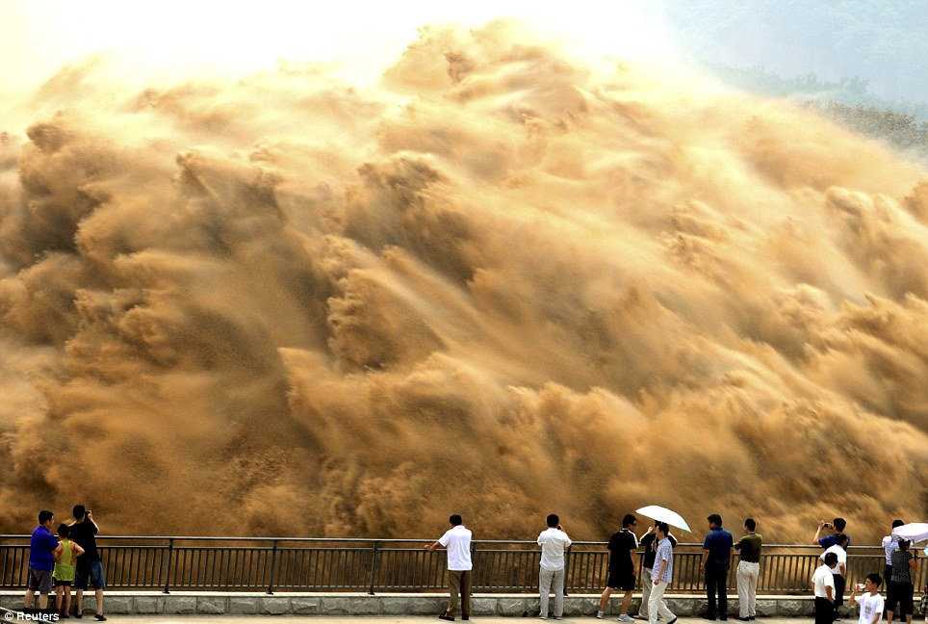

Slide 7
Tiger Woods of the U.S. watches his shot on the fifth tee during a practice round ahead of the British Open golf championship

Slide 8
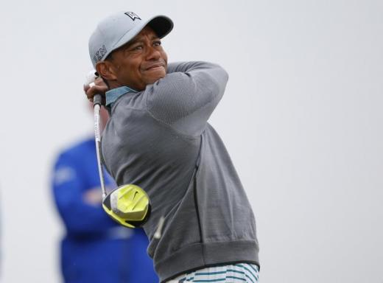

Slide 9
Pope Francis (L) watch a dance performance next to Paraguay's President Horacio Cartes upon his arrival

Slide 10
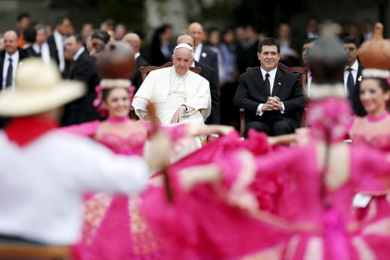

Slide 11
Palestinians watch as smokes rises from
an Egyptian coastguard vessel
on the coast of northern Sinai

Slide 12
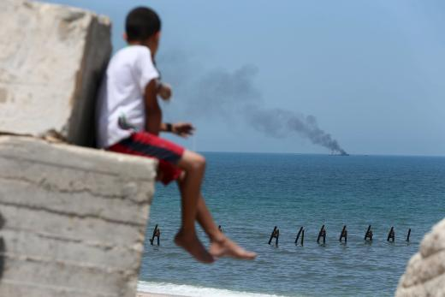

Slide 13
Revelers watch each other twerk to music from a nearby club along Bourbon Street, located in the French Quarter of New Orleans

Slide 14
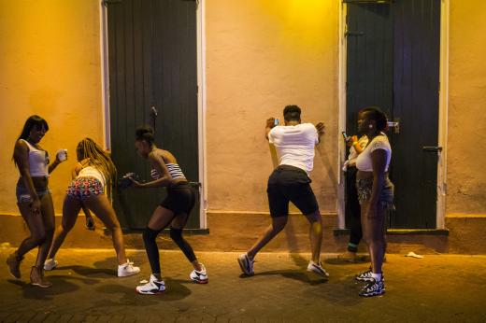

Slide 15
Wisconsin Governor Scott Walker watches his wife Tonette address the crowd as he stands backstage looking at a TV monitor

Slide 16
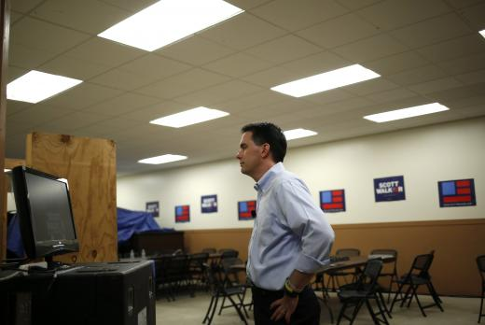

Slide 17
People watch from across the street
as demonstrators rally
against Japan's Prime Minister
Shinzo Abe's administration

Slide 18
